Slide 1

RST_app
Data Inputs
catch_data
visit_data
release_data
recapture_data
Outputs
passage_estimates
efficiency_results
catch_results
summary plots
est_passage.R
User Inputs
summarize.by
bootstrap
impute_all
survey_start
survey_end
passage_boot.R
summarize_passage.R
est_catch.R
calculate_sampling_time.R
fix_dates.R
assign_batch_date.R
est_efficiency.R
find_visits_near_release.R
model_catch.R
model_efficiency.R
summarize_index.R

Slide 2
RST_app next steps
Incorporate other species/run estimates.
Ensure only allowing species/runs which were used in efficiency trials.
Should users have to filter species/run before loading?
Hatchery vs wild fish for efficiency trials? How to incorporate this in efficiency modeling?
On Moke, have used salmon eff trials to inform steelhead passage.
Model output reports
User guide
Data formatting requirements.
Input options and out put information.
Methods documentation:
Detailed documentation that covers each function, inputs, outputs, and how modeling imputation is performed.

Slide 3
RST_app incorporating covariates
Start with just flow.
Allow user option to include flow or not.
Incorporate flow data with efficiency trials.
The harder part: have functions automatically compare AIC values between:
efficiency ~ time (and all spline options)
efficiency ~ flow
efficiency ~ flow + time (and all spline options)

Slide 4







RST_app
replicate CAMPR package
Testing with real and simulated data
Shiny application
Detailed documentation
Initial rollout
Continued support and updates

Slide 5
Potential next steps
Option 1:
Create documentation for RST_app in current base state.
Schedule meeting with potential users for early Summer.
Aim for initial rollout based on feedback.
Add covariate modeling after initial rollout.
Option 2:
Try and add flow covariate modeling first, then create documentation.
Schedule meeting with potential users for late Summer.
Aim for initial rollout based on feedback.

Slide 6
Testing data
Knights Landing:
2021-01-19
2021-06-30
Demo data (Feather):
2022-01-01
2022-06-30

Slide 7
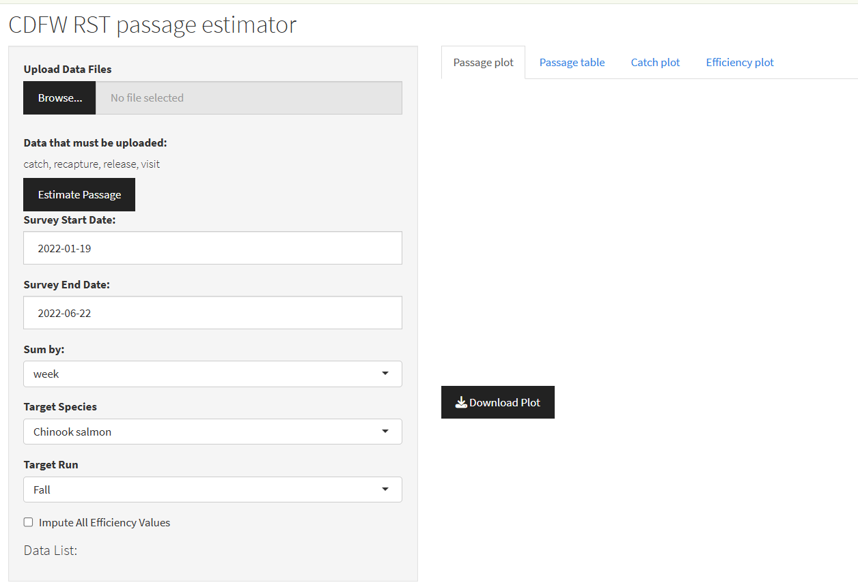

Slide 8
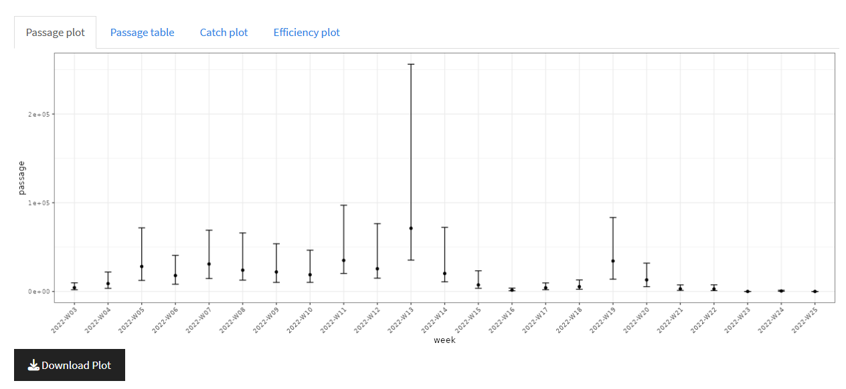

Slide 9
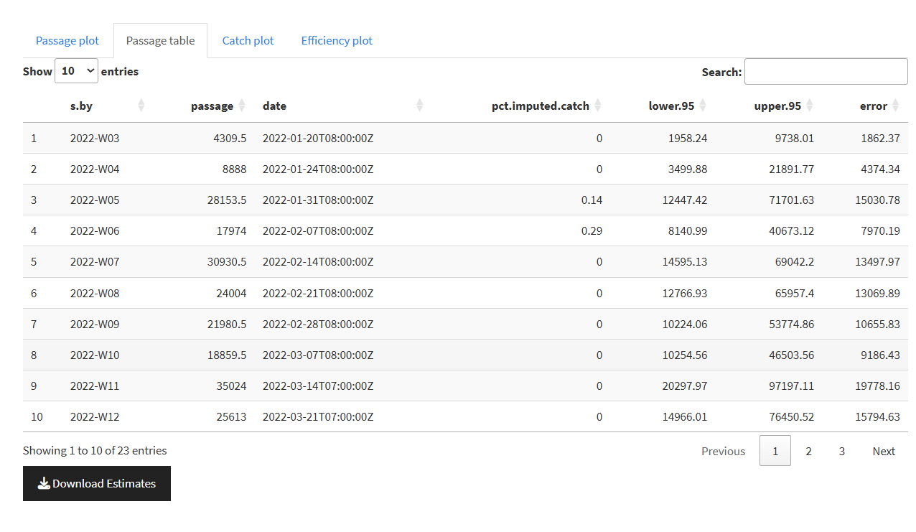

Slide 10
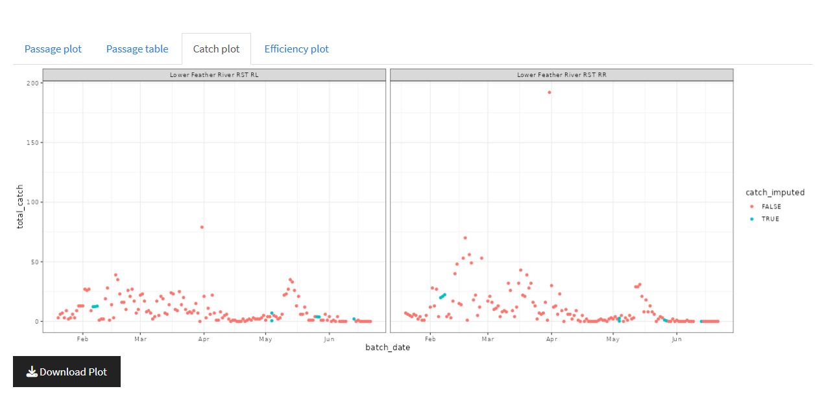

Slide 11
